Slide 1
Databases 11
Non-relational databases: overview, general introduction to Neo4j

Slide 2
I. Overview of NoSQL databases

Slide 3
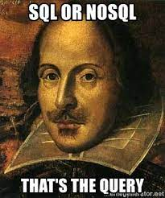
What is NoSQL?
SQL – is a language for the relational data model
NoSQL – is a way of data organization and managing which is different from relational model

Slide 4
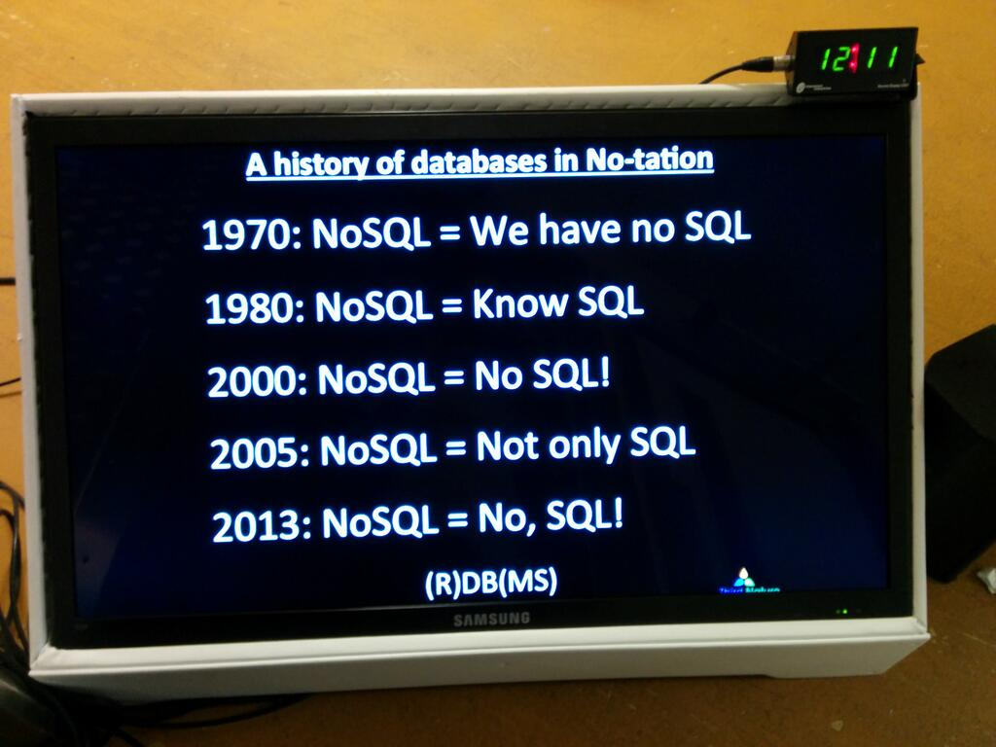
How NoSQL-DB and DBMS were created?
In fact, the first data organization systems did not comply with the provisions of the relational model. NoSQL is an organization for storing and processing data that has existed almost since the first production computers - after all, the data had to be stored somehow!

Slide 5
A little bit of history
At the very beginning - master files
Next (1960s) - network and hierarchical databases:
article by GE engineers Charles W Bachman, S. B. Williams “A general purpose programming system for random access memories” (1964/1965), data management system Integrated Data Store (IDS) (1963)
article by IBM engineer - William C. McGee “Generalized File Processing”, (1969), Information Management System (IBM IMS)
Conceptual heirs of hierarchical databases:
File systems
XML
Network databases have “turned” into graph databases
1969 – Edgar Codd publishes “A Relational Model of Data for Large Shared Data Banks” for IBM internal use (published 1970)

Slide 6
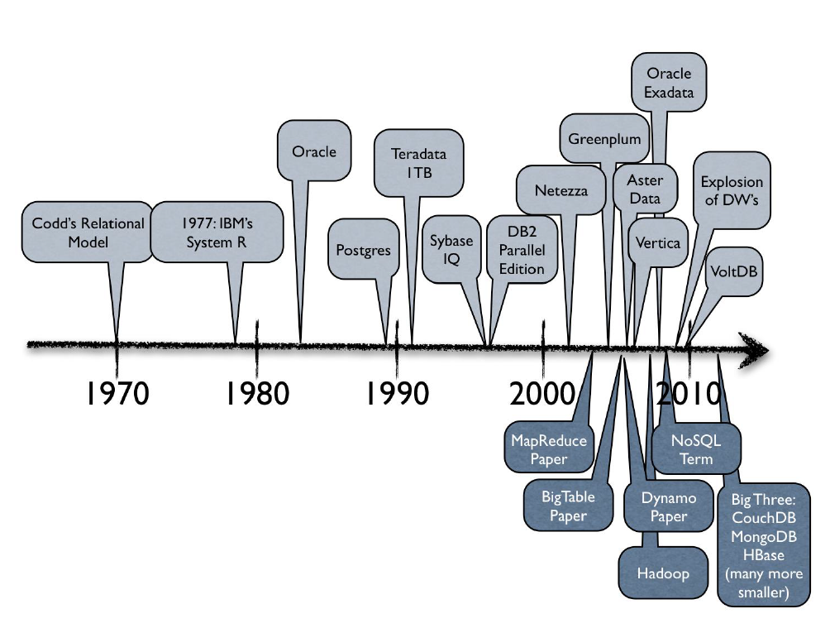
A little bit of history

Slide 7

Term NoSQL
The term 'NoSQL' appeared in 1998. It was used by developer Carlo Strozzi for his lightweight DBMS, which, although not using SQL, implemented a relational model.
Some say that now instead of the term NoSQL it would be more correct to use the term NoREL

Slide 8
Trends in the development of database models in 1990
BigData – large volumes of data, scalability
Web – ensuring data availability for any resource
Agile – speed of development (MVP is completed in 3-4 months)

Slide 9
RDB principles: ACID
Atomicity
Consistency
Isolation
Durability
IBM Information Management System (DBSM) has been started to support ACID since 1973

Slide 10
CAP - theorem
According to the theorem, there are three main properties that characterize any database (DBMS):
Consistency
Availability
Partition tolerance
and we can maximize no more than two of them
Application:
allows you to classify all database models according to pairs of specified properties.
Proposed by E. Brewer in ~2000

Slide 11
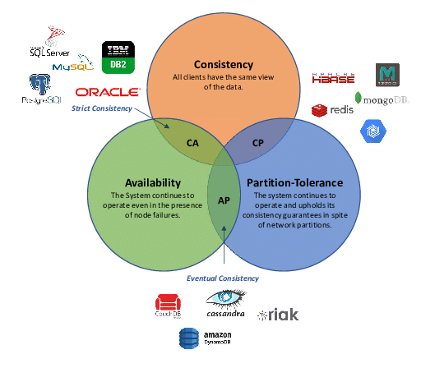

Slide 12
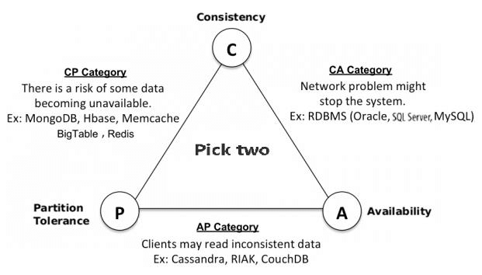
CAP: disadvantages of pairs

Slide 13
Alternative for ACID - BASE
The BASE model appeared as a “consequence” of the CAP theorem. It is “guided” when designing NoSQL DBMS and contrasted with ACID
BASE:
Basically Available
- Guaranteed response to every data request
Soft State
- Data may change in the absence of input operations
Eventual Consistency
- Ultimately (when input operations stop) changes in the data will be pushed to all database nodes

Slide 14
NoSQL: classification
There are many categories of NoSQL systems, for example:
Key-Value Stores
Column-oriented DBMS
Document Stores
Graph DBMS
RDF Stores (data presented in triplets: subject-predicate-object)
Native XML DBMS
Content Stores (storing entire content, including metadata)
Search Engines (search engines, e.g. Elasticsearch)

Slide 15
NoSQL: classification
The following four main types of NoSQL models are considered:
GraphDB
Document DB
Key-Value Stores
Column-oriented DB (special case - Wide-column DB)
- Let’s take a closer look at each of these types

Slide 16
Column-oriented vs Wide-column
Column-oriented database:
Primary Use: Optimized for aggregation operations and analytical queries that read large amounts of data from specific columns across an entire table.
Data storage: Data is stored in columns, allowing for fast data aggregations and compression as columns contain the same type of data.
examples: Apache ClickHouse, Vertica, SAP HANA

Slide 17
Column-oriented vs Wide-column
Wide-column database:
Main purpose: designed for scalability and flexibility in applications that require processing large amounts of data with different structures.
Data storage: Data is organized in tables, where each row can have a different number of columns and structure. Columns are grouped into column families that are stored together, improving read and write performance.
examples: Apache Cassandra, Google Bigtable, Apache HBase.

Slide 18
Column-oriented vs Wide-column
Storage structure: In column-oriented databases, the structure is fixed and uniform, each record or row contains data for each column. In wide-column databases, each row can have a different set of columns, which gives additional flexibility in data management.
Column Families: Wide-column databases use the concept of column families, where columns that are logically related to each other are stored together. This distinguishes them from column-oriented databases, where columns are not typically grouped in this way.

Slide 19
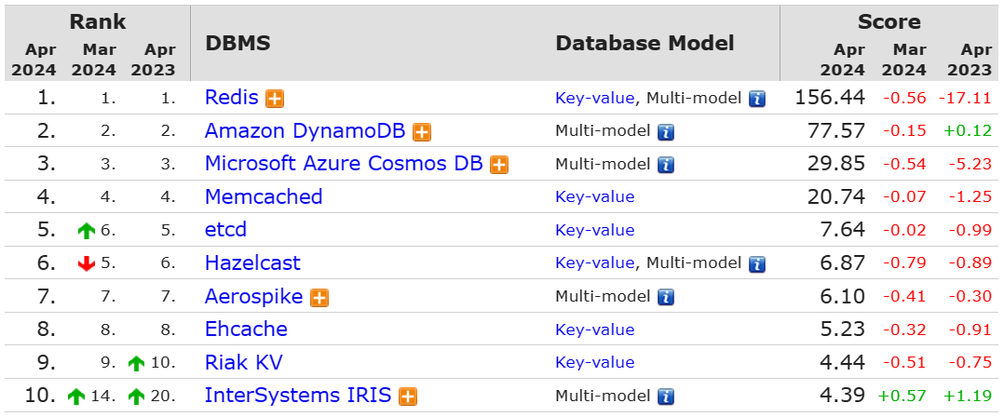
NoSQL: Key-Value Stores / overview

Slide 20
NoSQL: Key-Value Stores / Characteristics
Advantages:
The simplest type of the others. The principle of operation is similar to the associative array on hash tables
There is no data schema, value can be any object, the key can be an array rather than a single value
Disadvantages:
Due to the need to scan the entire hash table when reading, it may not scale very well
Suitable only for very simple data - it is impossible to implement connections using the model itself
Difficulty building complex queries

Slide 21
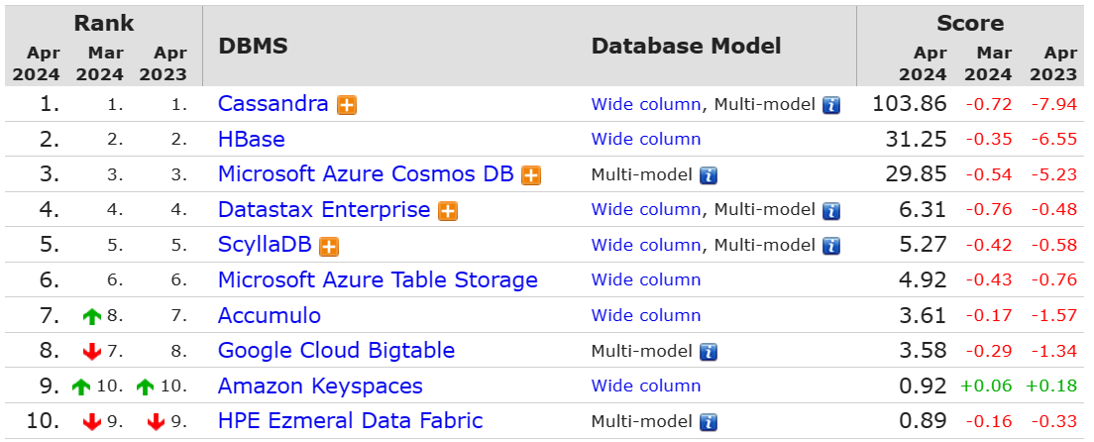
NoSQL: Wide-column DB / Overview

Slide 22
NoSQL: Wide-column DB / Characteristics
Advantages:
Flexibility in physical data storage – table rows are distributed across different servers, a row can contain columns of different data types
Fast processing of queries related to retrieving data from a column
Good compression (due to serialization of columns, i.e. arrays storing the same type of data)
Disadvantages:
Long (compared to RDBMS) processing of queries that retrieve entire rows. Long processing of JOIN queries, etc. – where line-by-line reading is required
Long (compared to RDBMS) writing data to a string
(almost complete) inability to create composite indexes

Slide 23
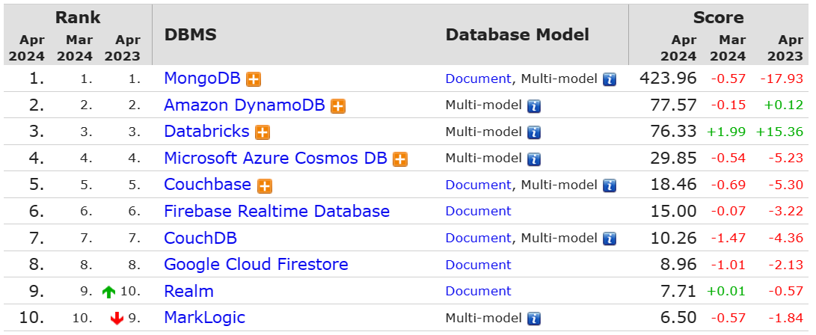
NoSQL: Document DB / overview

Slide 24
NoSQL: Document DB / Characteristics
Advantages:
No data schema support
Convenient format (MongoDB – JSON, one of the web standards)
Fast write/read
Convenient replication and sharding
Disadvantages:
No data schema support!!!
Poor support for complex SQL-like queries

Slide 25
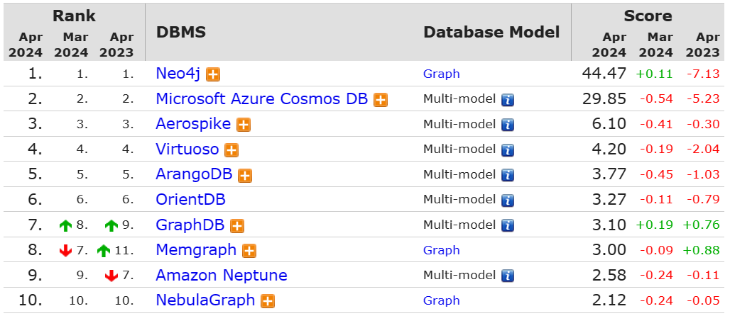
NoSQL: Graph DB / Обзор

Slide 26
NoSQL: Graph DB / Characteristics
Advantages:
It is based on a well-developed mathematical model
It is convenient to build specific models of the subject area - knowledge bases
Convenient data model extension
Speed of query processing due to the specifics of the data model
Disadvantages:
Heterogeneous query languages – no industry standard
Does not support transaction abstraction
It is difficult to calculate queries with aggregation

Slide 27
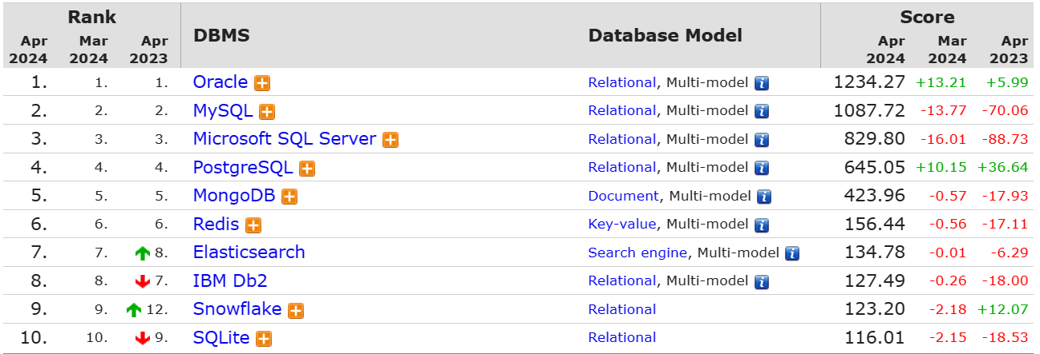
SQL vs NoSQL: реальное положение дел

Slide 28
NoSQL: advantages
Allows you to store large volumes of semi-structured information in a more or less coherent form
Ease of scaling (compared to RDB and RDBMS)
Convenient replication and sharding
Speed of development

Slide 29
NoSQL: disadvantages
No domain diagram design required
Encourage accumulation of inconsistent information in the database
For complex subject areas: the data schema tends to be relational (for the corresponding data categories). At the same time, the advantages of the relational model remain unavailable
Eventual consistency and the BASE principle introduce risks of error

Slide 30
And finally... Vector databases
At its core, this is not some new type of database, but something like an add-on over existing storage systems. Key-value databases can be used as a “backend” in such databases
The goal is to optimize the storage and processing of vector embeddings
Conceptually includes three parts: data store, vector indexing mechanism, query mechanism
Indexing and queries are processed using special libraries that are not related to database technology. The standard option is FAISS (Facebook AI Similarity Search). An important difference from query results in other types of databases is that the correctness of the result is probabilistic.

Slide 31



Examples
Milvus
Pincone
Weaviate

Slide 32
II. Introduction to Neo4j

Slide 33
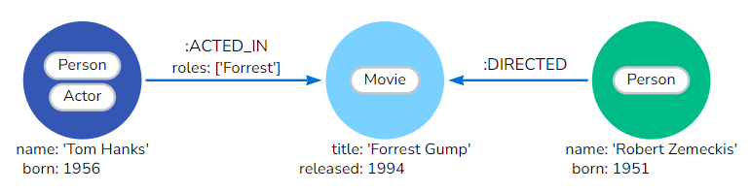
Neo4j: data model
Data and relationships between them are represented in the form of 3 model objects:
nodes
relationships
properties.

Slide 34
Neo4j: Nodes
Nodes represent entities or objects in a graph. They are similar to records or objects in a traditional database.
Each node can have one or more labels that define its role or type in the graph.
Tags help you organize and query data efficiently.
Nodes can have properties, which are key-value pairs that provide additional information about the node. Properties can be indexed for faster searching.
Nodes can have labels
Example syntax for creating a node:
CREATE (:Person:Actor {name: 'Tom Hanks', born: 1956})

Slide 35
Neo4j: Properties
Properties are key-value pairs that are used to store information about nodes and relationships.
The property value can:
contain different data types such as number, string or boolean.
contain a list (array) consisting, for example, of strings, numbers or Boolean values (the components must belong to the same type).
Example of properties with values of different types:
CREATE (:Example{a: 1, c: 'This is an example string', b: 3.14}, f: [1, 2, 3])

Slide 36
Neo4j: Relationships
A relationship describes how a source node and a target node are related. A node can have a connection with itself.
Relationships are always directed and have a start node and an end node. They represent a relationship between two nodes and can have a specific type or label.
Like nodes, relationships can have properties, which provide additional information about the relationship.
The syntax for creating a relationship is:
CREATE ()-[:ACTED_IN {roles: ['Forrest'], performance: 5}]->()

Slide 37
Neo4j: creation of elementary DB
CREATE (:Person:Actor {name: 'Tom Hanks', born: 1956})-[:ACTED_IN {roles: ['Forrest']}]->(:Movie {title: 'Forrest Gump'})<-[:DIRECTED]-(:Person {name: 'Robert Zemeckis', born: 1951})

Slide 38
Neo4j: CQL (Cypher Query Language)
Keywords similar to SQL are used: MATCH, WHERE, CREATE, DELETE, RETURN - and others
Example of pattern matching:
MATCH (me)-[:KNOWS*1..2]-(remote_friend)
WHERE me.name = 'Filipa’
RETURN remote_friend.name
Aggregating functions are allowed: COUNT, SUM, MIN, MAX
It is acceptable to use standard comparison operators and logical operators: >, <, =, AND, OR, NOT:
MATCH (node:Label)
WHERE node.property > 10 RETURN node
ORDER BY node.property
In addition to CREATE, constructs such as SET, DELETE, and MERGE are used to define data. Example of using MERGE:
MERGE (m:Movie {title: 'The Matrix', year: 1999})
Used to avoid data duplication (in the example above, the node will not be created if there is already a node with similar properties in the database)

Slide 39
Neo4j: extra opportunities
It is allowed to create indexes:
CREATE INDEX example_index_1 FOR (a:Actor) ON (a.name)
It is allowed to impose restrictions
CREATE CONSTRAINT constraint_example_1 FOR (movie:Movie) REQUIRE movie.title IS UNIQUE
Creation of custom functions is allowed

Slide 40
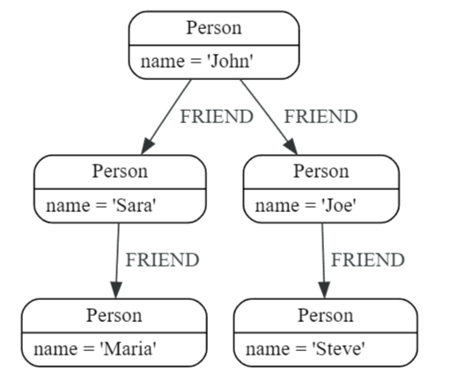
Neo4j: example
MATCH (john:Person {name: 'John’})
MATCH (john)-[:FRIEND]->(friend)
RETURN friend.name AS friendName

Slide 41
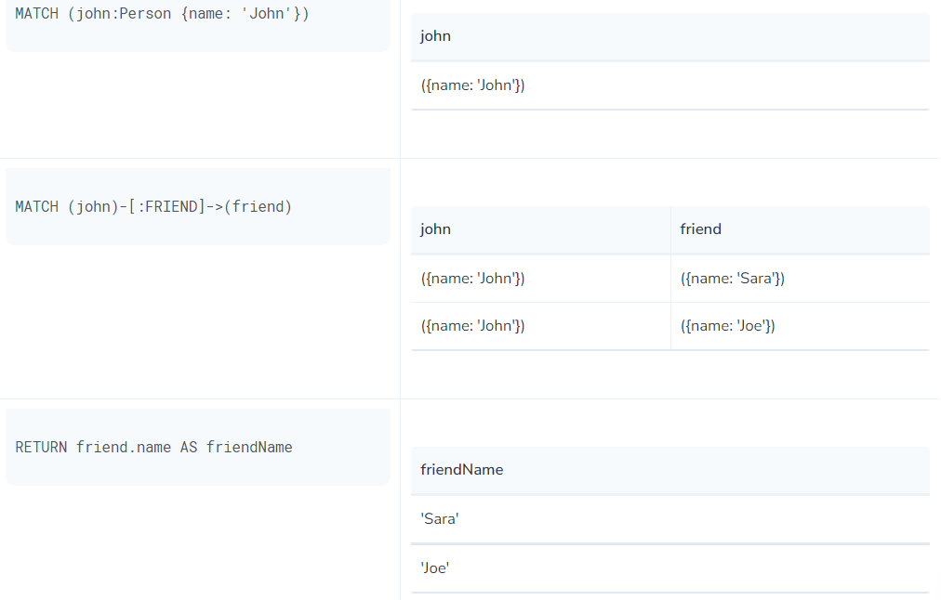
How does it work

Slide 42
Another example
MATCH (j:Person)
WHERE j.name STARTS WITH "J«
CREATE (j)-[:FRIEND]->(jj:Person {name: "Jay-jay"})
- the query finds all nodes whose name property begins with "J", and for each such node creates another node with the name property set to "Jay-jay".

Slide 43
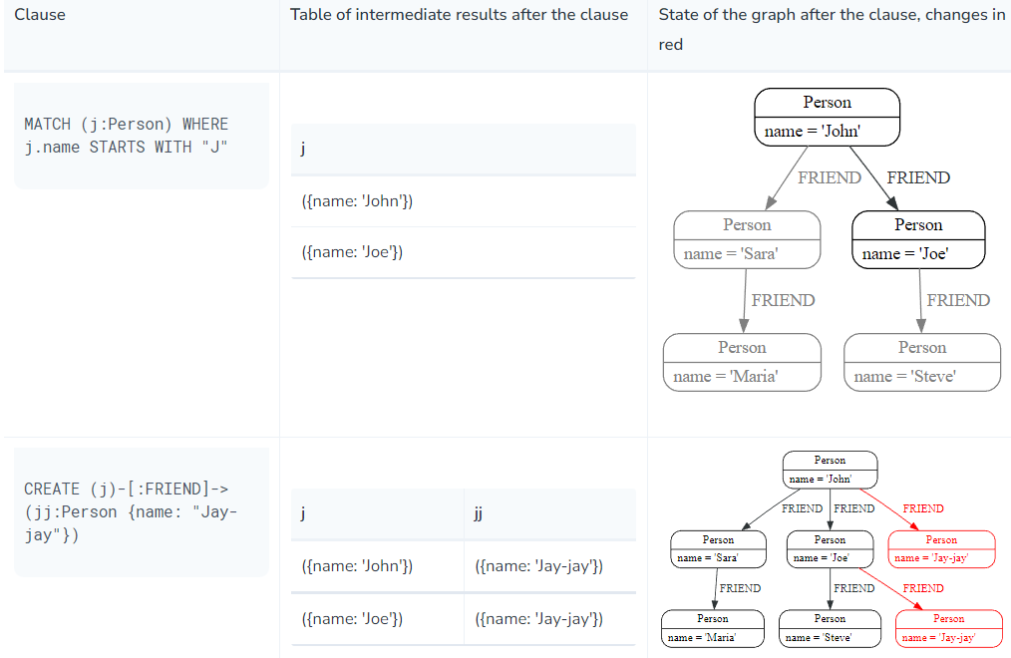

Slide 44
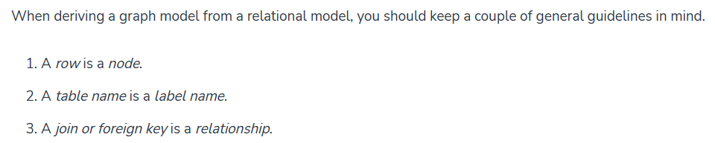
Recommendations for interpreting relational data into graph data from the official guide Neo4j (Tutorial: Import Relational Data Into Neo4j - Developer Guides):

